Slide 1

632
The Adult Income Dataset
A Machine Learning Analysis of USA Census Salary Data
Presented By :
Pradnya Mali

Slide 2

Pradnya Mali
Aspiring Data Scientist
Education
Skills
Contact
Post-graduation in Data Analytics and Machine Learning Imarticus Learning (2022-Present)
Bachelor of Pharmacy Mumbai University (2018-2021)
SQL
Address:
Pune, Maharashtra.
Python
Machine Learning
Contact Numbers:
+91 8390045286
Work Experience
Statistics
Email Address:
malipradnya810@gmail.com
Data-Visualisation
Internship Trainee (2022)
Languages
Sparks Foundation( Data science and business Analytics.
Hobbies
English
Understood to analyze data for actionable insights. Specific tasks include: Identifying the data-analytics problems .
Determining the correct data sets and variables.
Marathi
Video
Music
Travelling
Hindi

Slide 3

Agenda
INTRODUCTION
FEATURE INFORMATION
EXPLORATORY DATA ANALYSIS
FEATURE SELECTION
MODEL BUILDING
MACHINE LEARNING ALGORITHM
ENSEMBLE TECHNIQUES
DECISION ALGORITHM
COMPARING PARAMETERS
CONCLUSION

Slide 4
INTRODUCTION
Problem Statement :TEXT HERE
The goal of this machine learning project is to predict whether a person makes over 50K$ per year or not given their demographic variation.
This Data Set Contains 32561 Instances and 15 features that are a mixture of categorical, ordinal, and numerical data types.
Source : https://archive.ics.uci.edu/ml/machine-learning-databases/adult/

Slide 5
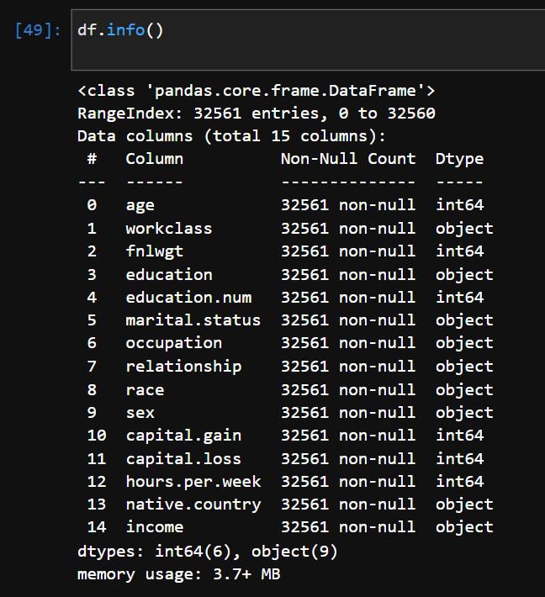
Here is the set of variables contained in the data
age
workclass
fnlwgt
education
education_num
marital
occupation
relationship
race
sex
capital_gain – Capital gains recorded
capital_loss – Capital Losses recorded
hr_per_week
country
INCOME – Boolean Variable

Slide 6
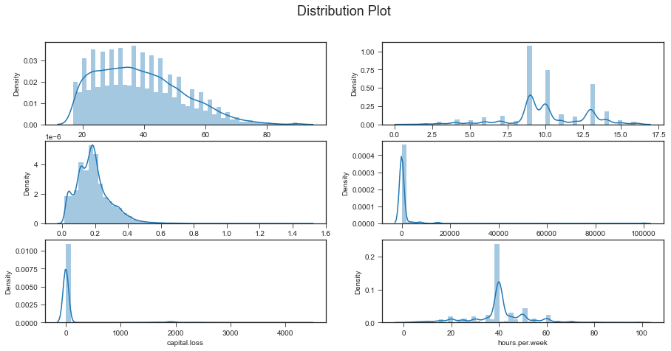
Exploratory data Analysis

Slide 7
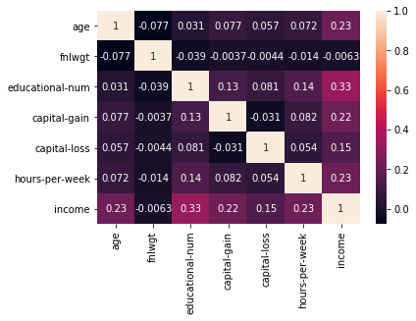

Slide 8
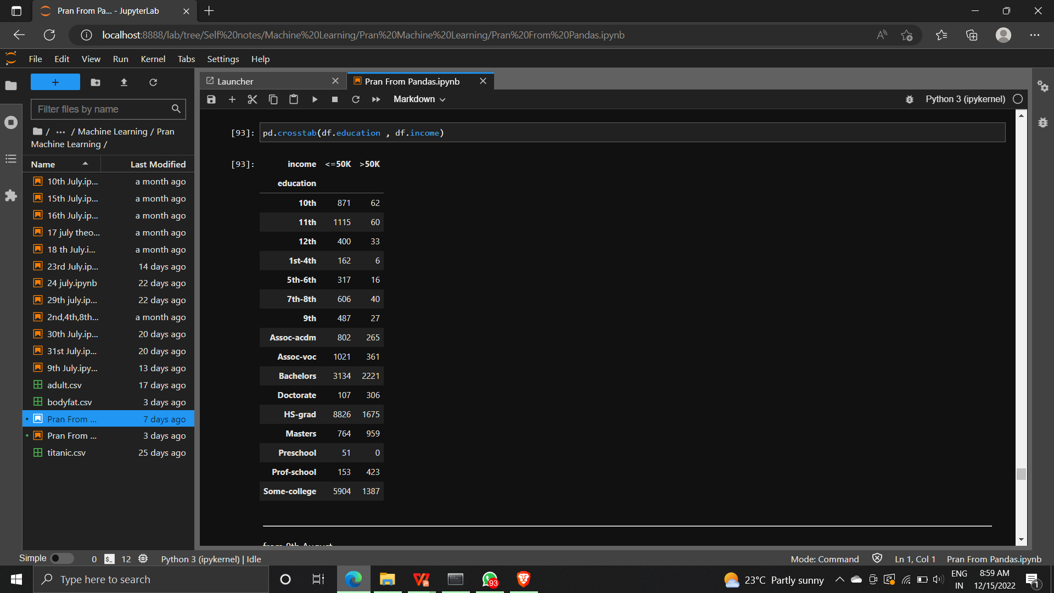
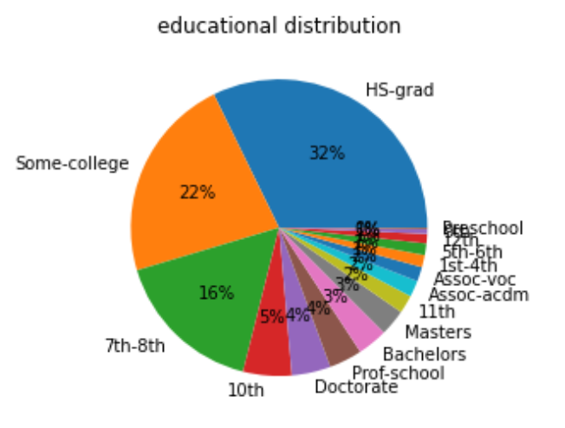

Slide 9
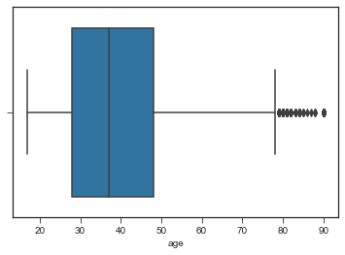
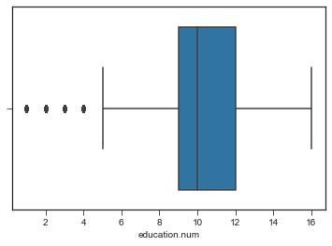
Box plot
Before handling outliers.

Slide 10
Removing outliers
for cols in df.columns:
if df[cols].dtype!='object':
q1=df[cols].quantile(0.25)
q3=df[cols].quantile(0.75)
q2=q3-q1
low=q1-(1.5*q2)
high=q3+(1.5*q2)
(df.loc[(df[cols]<low) | (df[cols]>high),cols])=df[cols].median()

Slide 11
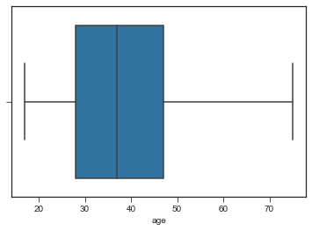
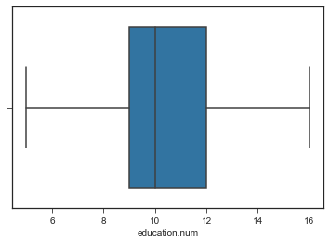
After Handling outliers.
After Handling outliers.

Slide 12
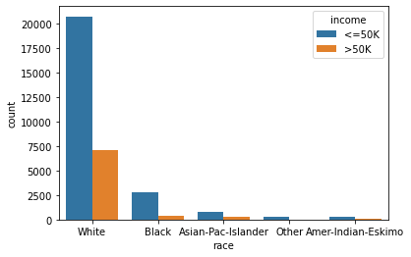
This count plot shows the graph race vs income. It clearly shows that white race get more income than the other race.

Slide 13
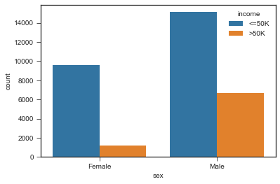
This is another obeservation from dataset , the countplot shows Sex vs income. It shows that Males are higher income than females.

Slide 14
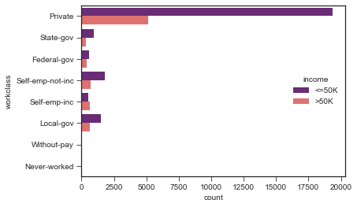
This plot is about workclass vs income and shows that private workclass get higher income than other workclasses.

Slide 15
Handling Categorical to Numerical
from sklearn.preprocessing import LabelEncoder
le = LabelEncoder()
# short way of applying encoder
df[df.select_dtypes(include = ['object']).columns] = df[df.select_dtypes(include = ['object']).columns].apply(le.fit_transform)

Slide 16
Data Standardization :
Using Standardization we have converted every entry between the range of mean = 0 and standard deviation = 1
We try to have a bell shape curved with normal distribution of our data
we performed standardization, because best fit line or curve is sensitive to new data points or outliers

Slide 17
Data Balancing :
We have 19775 records for class 0 [Income less than 50k$]
We have 6273 records for class 1 [Income greater than 50k$]
Techniques to handle Imbalanced Data:
Stratified Sampling
Oversampling
Undersampling
Over and Undersampling

Slide 18
Stratified Sampling :
x_stratified = final_df.iloc[:,:-1]
y_stratified = final_df.iloc[:,[-1]]
x_train,x_test,y_train,y_test=train_test_split(x_stratified,y_stratified,train_size=0.8,stratify=y_stratified,random_state=0)
Class 0 records for tranning=19775
Class 1 records for tranning=6273
Tranning ratio=3.14
----------------------------------------------------------------------------------------------
Class 0 records for tranning=4945
Class 1 records for tranning=1568
Testing ratio=3.14

Slide 19
Comparing results with oversampling and stratified samplings
Algorithem name | Accuracies with oversampling | Accuracies with stratified sampling
Logistic regression | 73.3 | 80
KNN | 74 | 81.4
Dicission Tree classifier | 76.63 | 78.2
Random Forest classifier | 79.13 | 81.89

Slide 20
Comparing results with Accuracy and cross valiadation Accuracy :
Model | Accuracy | Hyper Parameter | Cross Validation
Logistic Regression | 0.80 | Penalty = 12 Solver = Newton-cg | 0.803
KNN | 0.814 | Metric = ‘ Minkowiski’ n_neighbours = 15 weights = uniform p = 1 | 0.832
Dicision Tree | 0.782 | Criterion = entropy max_depth = 11 min_sample_split = 4 min_sample_leaf = 7 | 0.836
Random Forest | 0.8189 | n_estimators = 95 criterion = entropy max_depth = 31 min_sample_split = 4 min_sample_leaf = 7 | 0.847

Slide 21
Model | Accuracy | Hyper parameter | cross validaton
Bagging | 0.807 | n_estimator = 51 bootstrap = True oob_score = True | 0.832
SVM | 0.785 | Degree = 2 | 0.785
AdaBoost | 0.813 | base_estimator = dt lr = 0.01 n_estimator = 25 | 0.837

Slide 22
Hypothesis by our own and its Applications of Model :
Goverment wants to launched new taxession scheme using machine learning and using this data. Goverments wants this scheme in favour of citizens.
If someone with income more than 50k if comes under class 0, and paying lower tax it is acceptable but someone with income less than 50k and still classify under class 1, it will nots be accepted.
So , our aim will be choosing model having,
Lower FPR
Higher accuracy
Higher Precission
. government is ready to accept bit lower TPR

Slide 23
Choosing best fit model according to problem statement :
Name of model | FPR | PRECISSION SCORE | ACCURACY | RECALL SCORE | ROC-AUC SCORE
Dicission tree | 8.2 | 73 | 83.6 | 59.2 | 73.39
Random forest | 7.6 | 71 | 84.7 | 58 | 74.3
Adboost technique | 8.3 | 68.83 | 83.7 | 58.3 | 74.8
Conclusion: According to problem statement Random forest seems to be performing well.

Slide 24
Thank you

